Slide 1
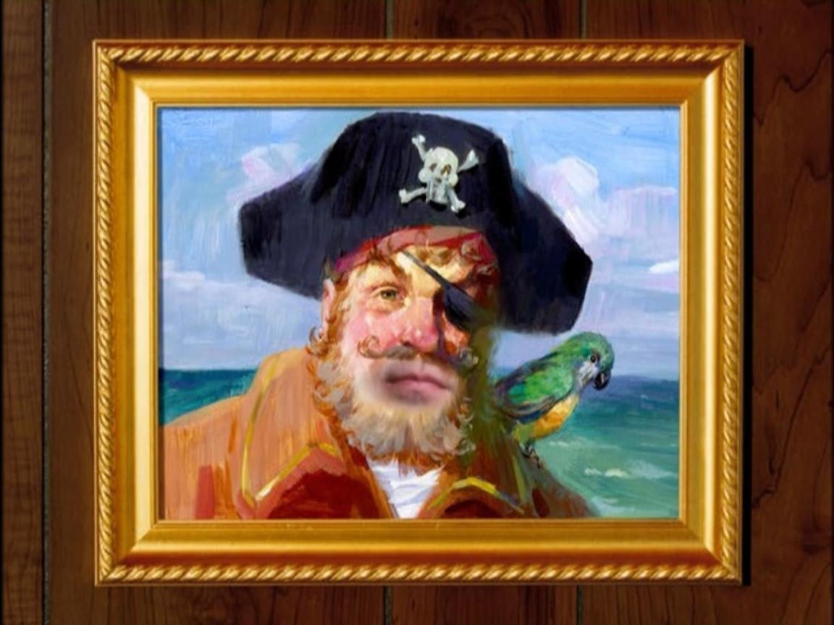
Are you ready, kids?!

Slide 2
Analysis of Social Interaction between “SpongeBob SquarePants” Characters
Liad Nahmias
Michael Khavkin

Slide 3
Introduction Analysis of literary text
Analysis of literary text is not only limited to books but also to other written literature:
Tweets, Internet blogs, transcript of movies and television shows
Challenge - not always the data are publicly available:
Some of the data is unstructured, or not fully formatted
Crawlers can be implemented to extract the online media

Slide 4
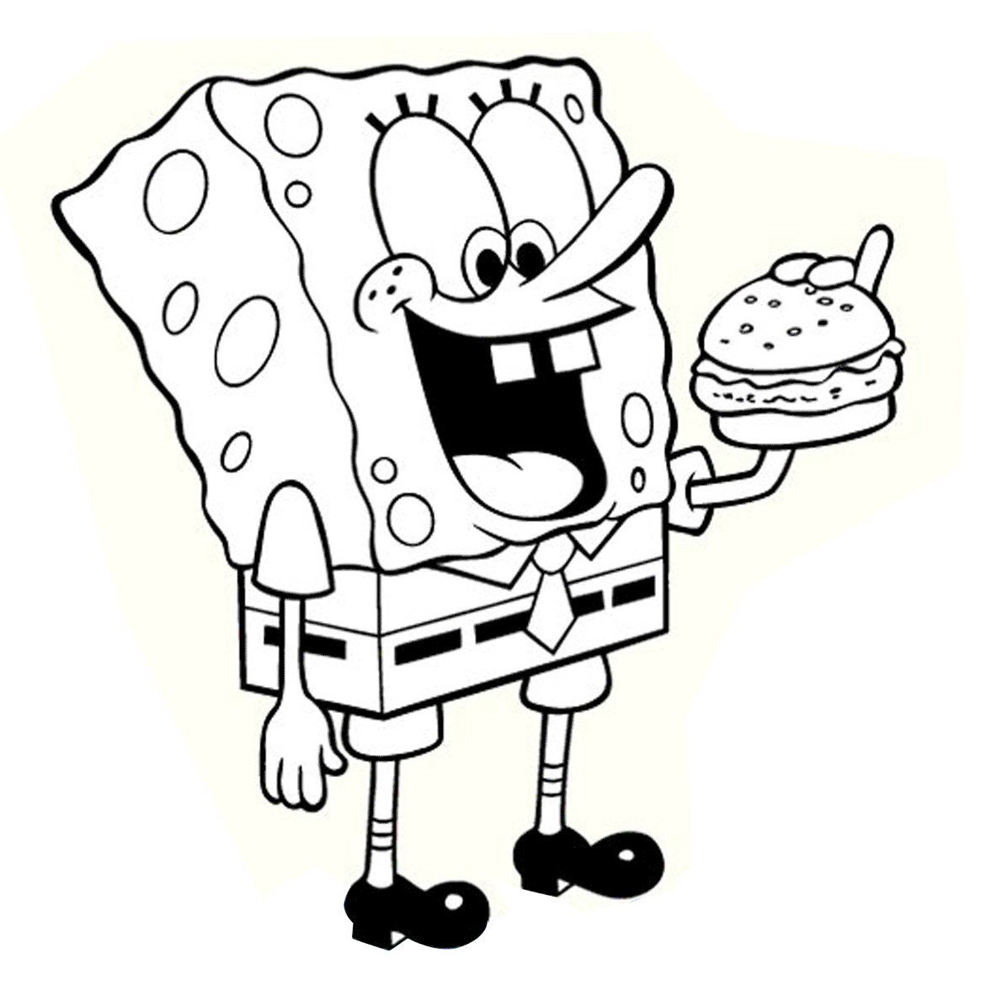
Introduction About the show
SpongeBob SquarePants is an American animated television series created by marine biologist and animator Stephen Hillenburg for ”Nickelodeon”
First broadcasted on 01.05.1999
Number of seasons: 11
Number of episodes: more than 220
https://www.pinterest.com/pin/396739048399587469/

Slide 5
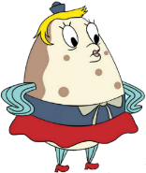

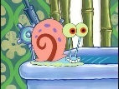

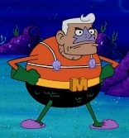
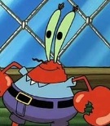

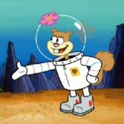
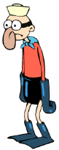
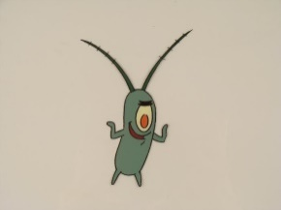
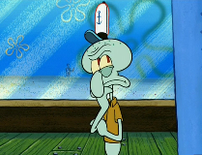
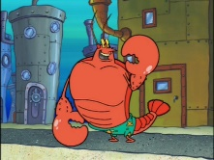
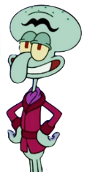
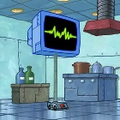
Introduction Roles and relationships
Mrs. Puff
Patrick
Gary
Pearl
Super Heroes
Mermaid Man
Teacher
Friend & neighbor
Pet
daughter
Sandy
Boss
Friend
Rival
Mr. Krabs
SpongeBob
Plankton
Boss
The cool guy
Neighbors & Co-workers
Larry
Barnacle Boy
Wife
Squilliam
Nemesis
Squidward
Karen

Slide 6
Related Work
Recent research studied the interaction between characters in the nineteenth-century British novels and serials (Elson et al., 2010).
Social networks were derived from dialogue interactions.
Character name chunking
Quoted speech attribution
Conversation detection

Slide 7
Data
Data source:
Episode transcripts
http://spongebob.wikia.com/wiki/List_of_transcripts.
Crawler:
Home-made Python crawler
406 extracted transcripts (each episode is divided into two parts of 15 min each)
Transcripts are formatted to <Speaker>:<Text> tags.

Slide 8
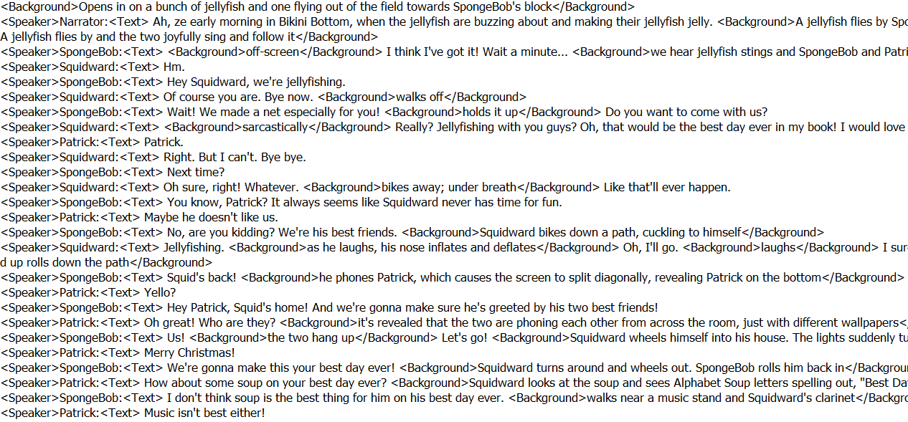
Data
Episode transcript format:

Slide 9
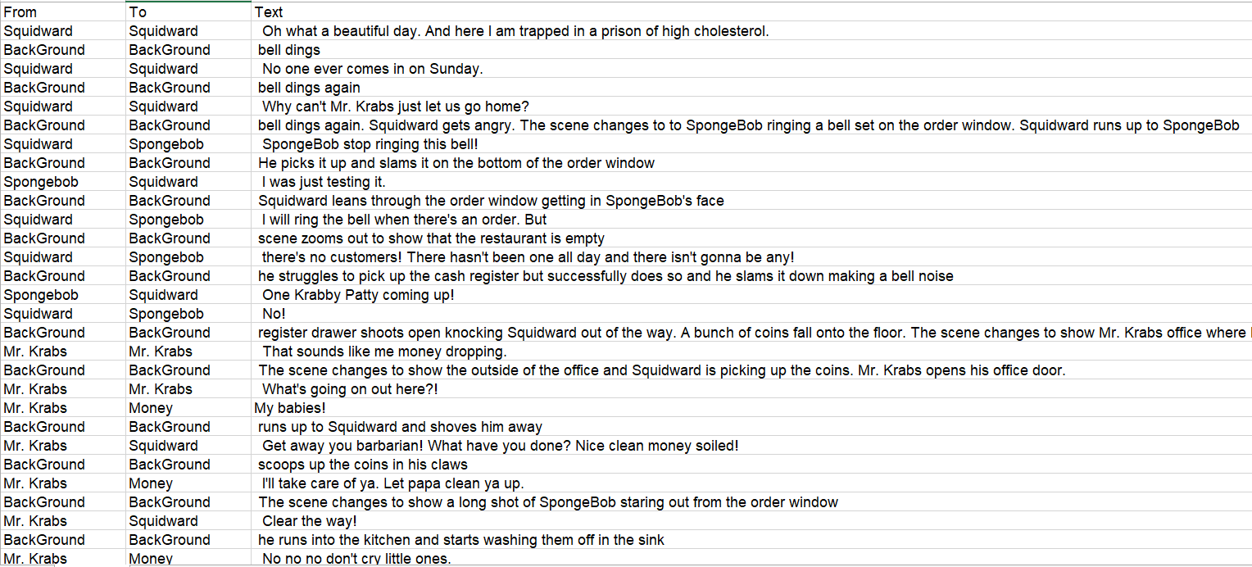
Data Pre-processing
We re-organized the raw transcripts to separate files for each character:
Each line contains the speaking character, the receiving character and the conversation text

Slide 10
Data Pre-processing
We tokenized each conversation and removed stopwords and any punctuation sings
Sentiment analysis was performed using raw text
We chose to focus on 14 main characters:
Spongebob, Patrik, Gary, Squidward, Sandy, Mr. Krabs, Mrs. Puff, Squilliam, Larry, Pearl, Plankton, Karen, Mermaid Man and Barnacle boy

Slide 11
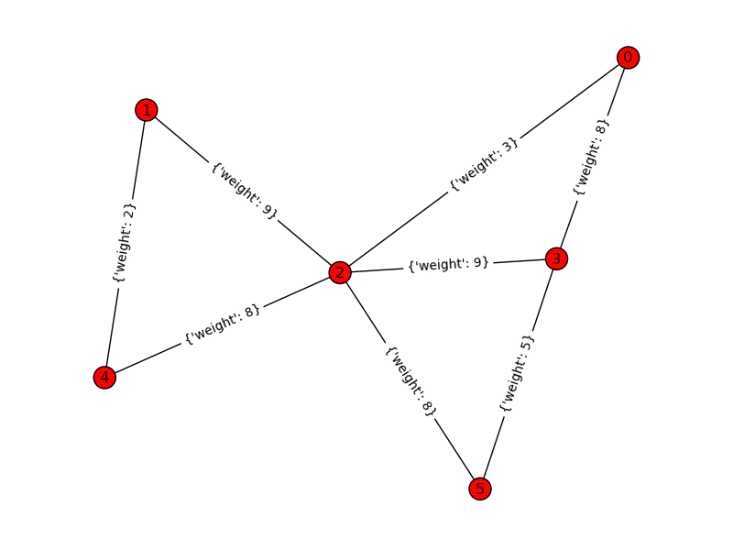
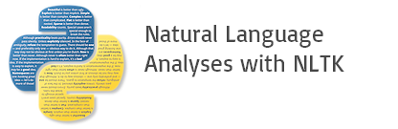

Tools and packages
We used three main packages for the processing of the texts and the social analysis:
Topic modeling: Gensim for extraction of topics and pyLDAvis for their visualization.
Sentiment analysis: NLTK
Social network construction: Networkx

Slide 12
Hypotheses
There is correlation between an expert analysis and an algorithmic NLP analysis.
Character with positive sentiment effects a negative character in their conversations.
The topics extracted from a character’s conversation depend on his dynamics with other characters.
The topics extracted from a character’s conversation are different in each episode.

Slide 13
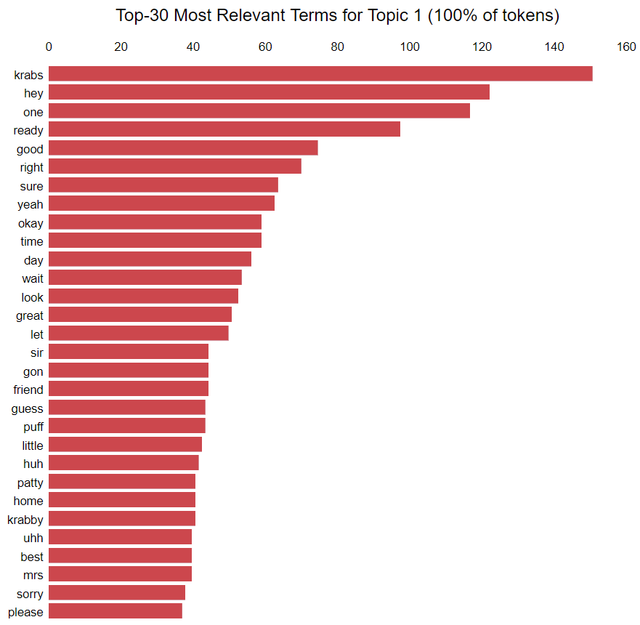
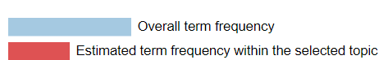
Experiments Topic Modeling
We have extracted the main 3 topics of the conversations for each character:
We use the pyLDAvis visualization to display the top 30 most relevant terms of each topic.
We consider the top 5 terms to indicate the overall social status of the character.
Topic model visualization for conversations of Spongebob (the most dominant topic), generated by the PyLDAvis package

Slide 14
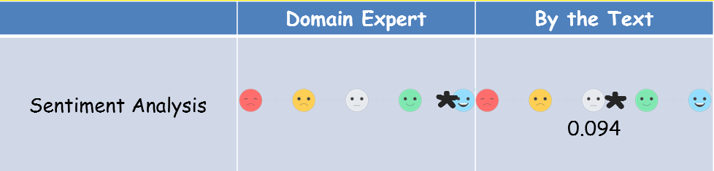
Experiments Sentiment Analysis
We classified each conversation to its sentiment (positive, negative or neutral):
The sentiment score is in the range between -1 (strong negative sentiment) and 1 (strong positive sentiment)
We used a threshold of 0.05 for the sentiment score
We average the sentiment score for all the conversations of a character to get a sense of its general mood
Spongebob average sentiment score from his conversations, compared to score annotated by a domain expert

Slide 15
Experiments Social Interaction analysis
We constructed the following interaction graph:
Each character entity was assigned to a vertex in the graph:
Only characters with a “PERSON” POS tag count of at least 2 are included
The size of each vertex is proportional to the character’s share in all the “PERSON” named entity mentions
The color of each vertex corresponds to common topics that appear in his conversations
Notes:
Following the idea behind the construction of the social network in [1], we constructed the following graph

Slide 16
Experiments Social Interaction analysis
We constructed the following interaction graph:
Each conversation (between two characters) is assigned a directed edge:
Green edges indicate positive sentiment, blue indicate neutral sentiment and red indicate negative sentiment
The labels on the edges show the average score of the sentiment
The width of an edge is proportional to the length of the conversation
Notes:
Following the idea behind the construction of the social network in [1], we constructed the following graph

Slide 17
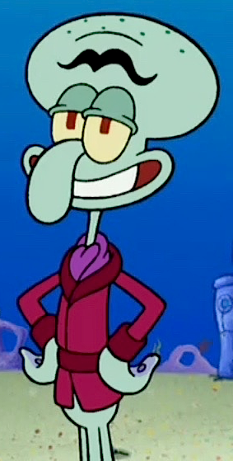
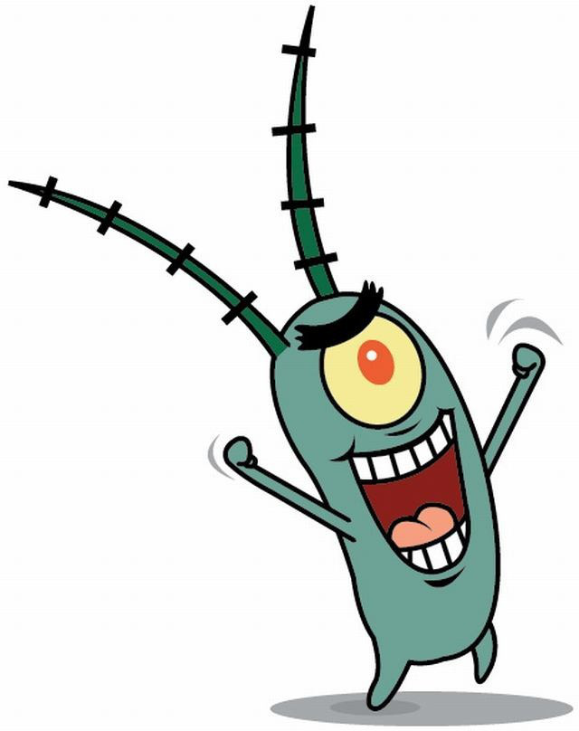
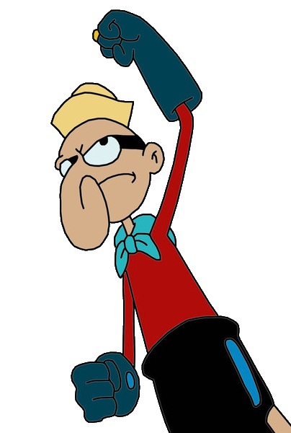
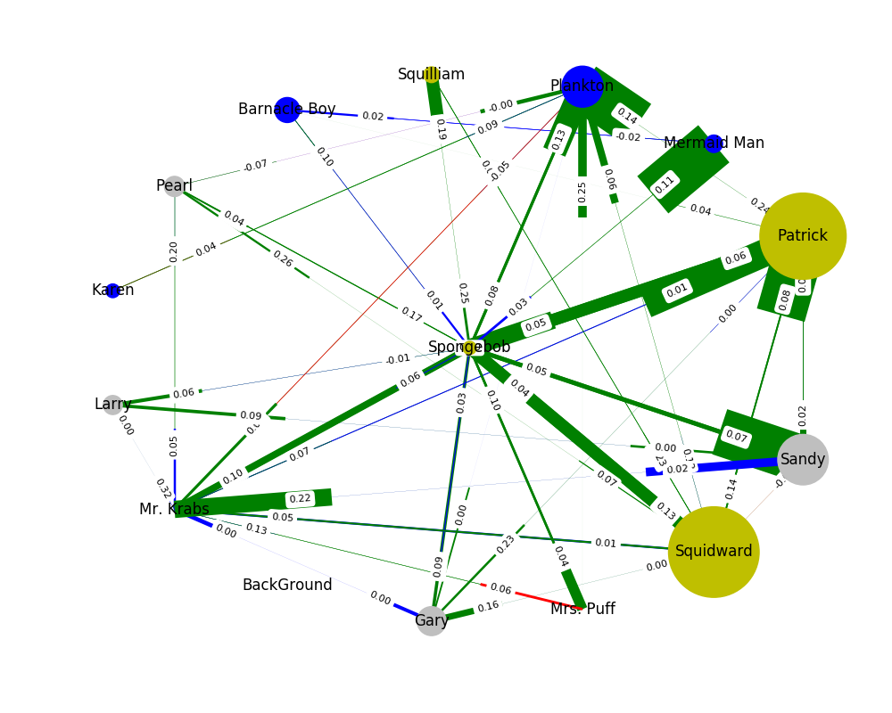

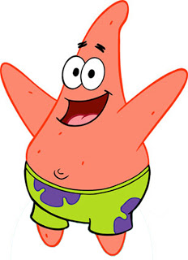
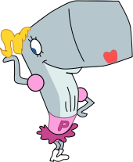
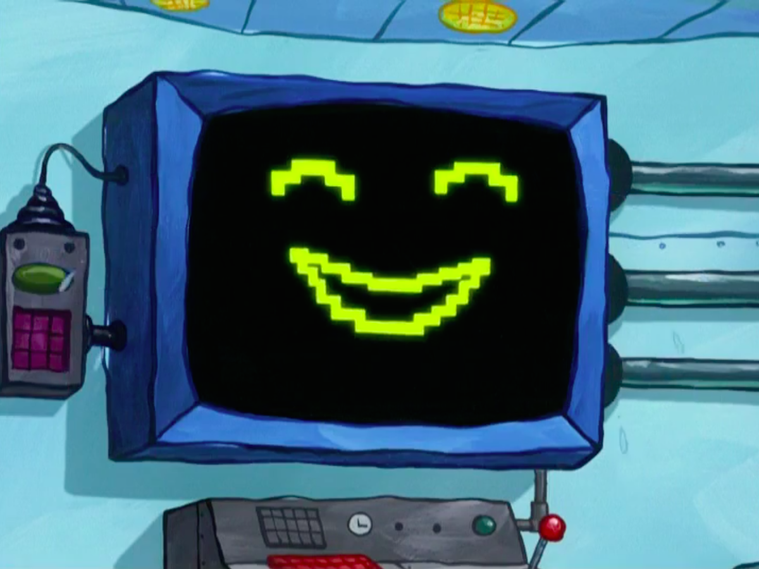
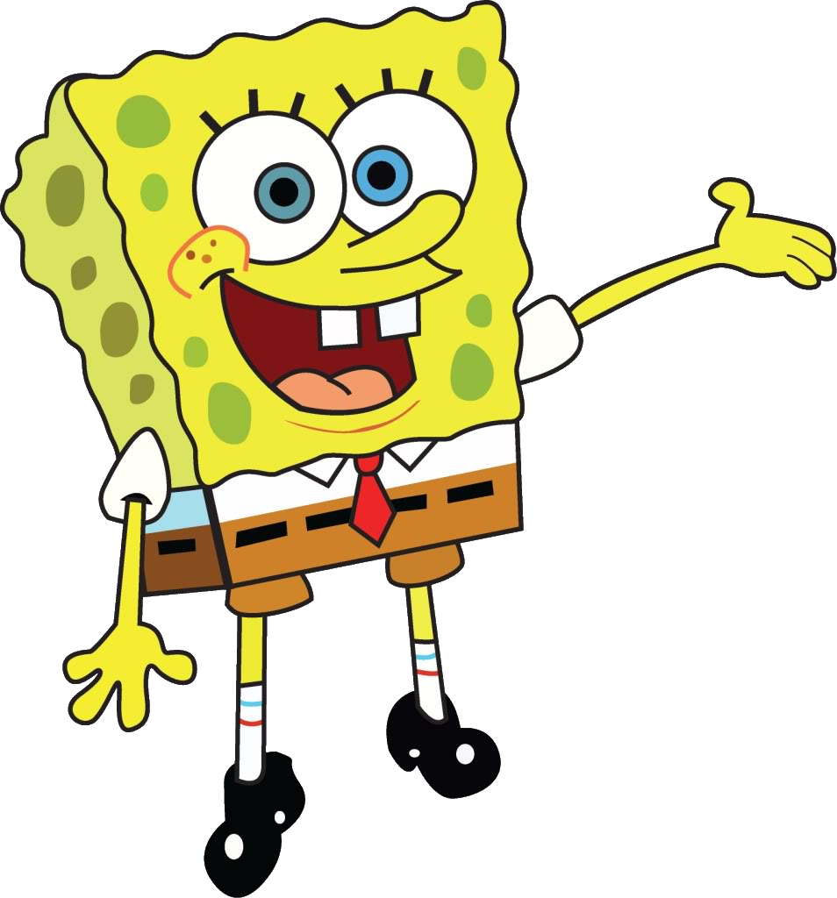
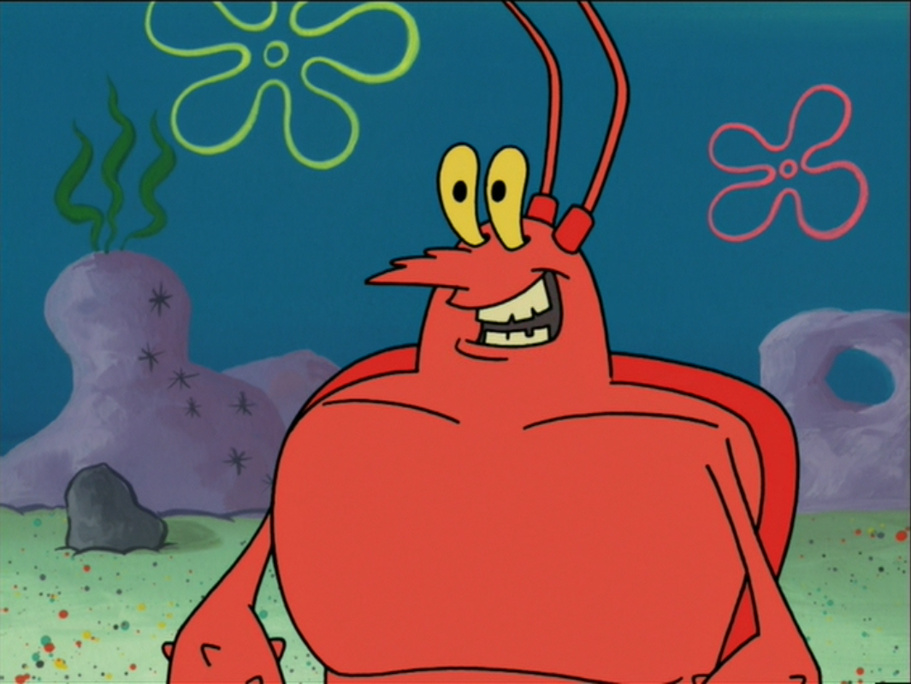
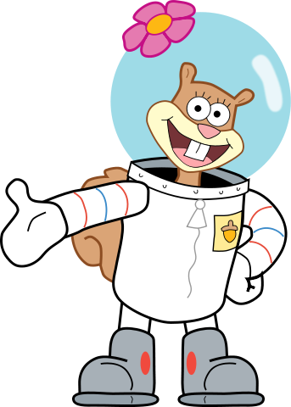
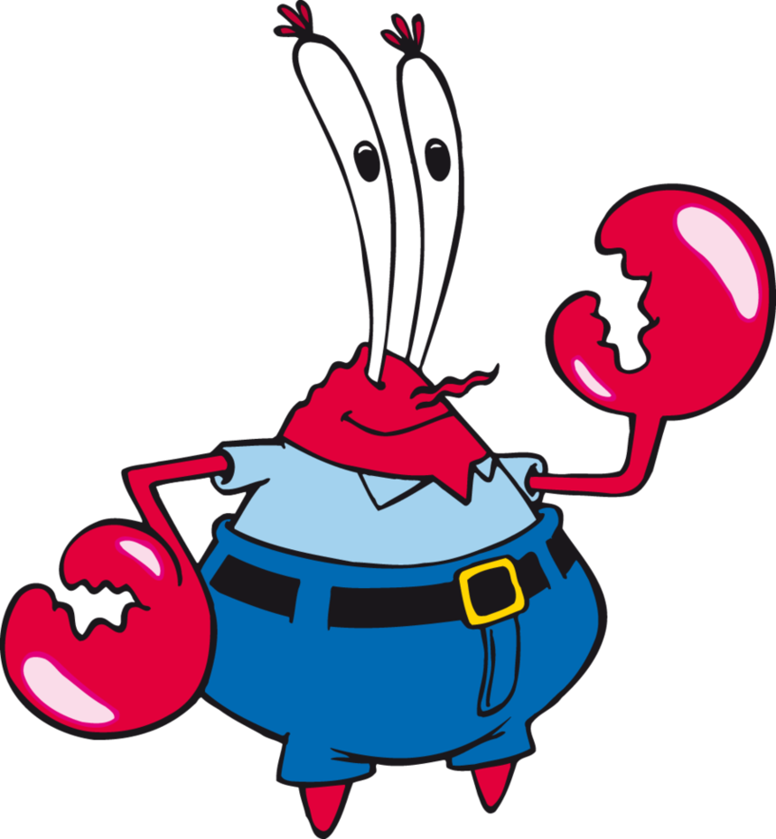
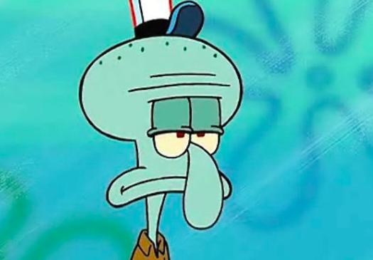
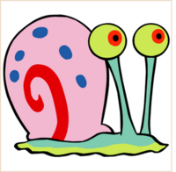
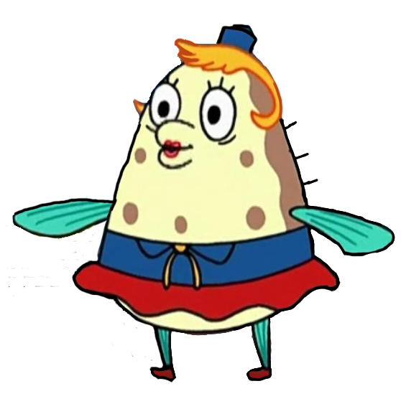
Graph Social Network

Slide 18
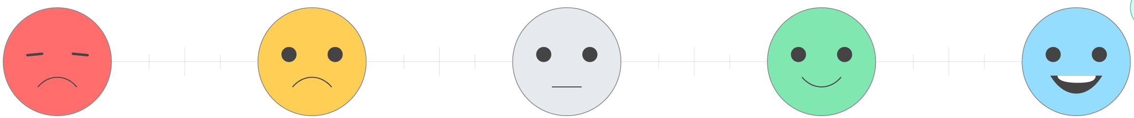
Results SpongeBob
NLP | Domain Expert
0.094 |  | Sentiment Analysis
 | Fun, Work, Karate | Main Topics
*
*
Topic | 5 Top words in each topic | Label
1 | krabs, hey, one, ready, good | Work
2 | sausages, hotter, sash-ringing, lima, yeh | Food
3 | drown, punch, national, anddone, vow | Commitments

Slide 19
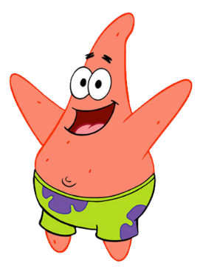
Results Patrick
NLP | Domain Expert
0.057 |  | Sentiment Analysis
 | Fun Doing nothing | Main Topics
*
*
Topic | 5 Top words in each topic | Label
1 | hey, good, gon, yeah, one | Good mood
2 | nets, puff, ate, dinga, living | Life style
3 | tastes, bowl, club, borrowing, carni | Food

Slide 20
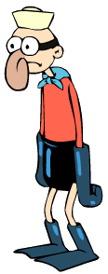
Results Barnacle Boy
NLP | Domain Expert
-0.001 |  | Sentiment Analysis
 | Justice | Main Topics
*
*
Topic | 5 Top words in each topic | Label
1 | man, invisible, mermaid, come, boatmobile | Super heroes
2 | let, signal, underwear, bob-acle, open | Equipment
3 | confound, jukebox, vision, bob-acle, show | Vision

Slide 21
Results Mermaid Man
NLP | Domain Expert
-0.043 |  | Sentiment Analysis
 | Justice, Evil | Main Topics
*
*
Topic | 5 Top words in each topic | Label
1 | evil, barnacle, boy, signal, man | Super heroes
2 | call, waterball, rest, right, squash | Power actions
3 | yes, move, see, remember, mode | Actions

Slide 22

Results Mr. Krabs
NLP | Domain Expert
0.05 |  | Sentiment Analysis
 | Money, Work, Sailor | Main Topics
*
*
Topic | 5 Top words in each topic | Label
1 | money, boy, one, day, wait | Money
2 | bib, relay, shenanigan, suggestions, prized | Honors
3 | photogeneric, years, okie, lass, scrape | Appearances

Slide 23

Results Larry
NLP | Domain Expert
0.035 |  | Sentiment Analysis
 | Working out | Main Topics
*
*
Topic | 5 Top words in each topic | Label
1 | muscle, hey, serious, pop-up, piston | Gym
2 | car, ambulance, guys, tonight, ball | Transportation
3 | thanks, slam, jerky, love, little | Feelings

Slide 24
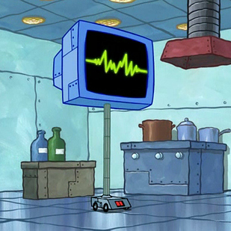
Results Karen
NLP | Domain Expert
0.02 |  | Sentiment Analysis
 | Evil Plans | Main Topics
*
*
Topic | 5 Top words in each topic | Label
1 | name, andcute, overload, vincent, gon | Computer performance
2 | decisions, hard, majesty, gorgeous, day | Complexity
3 | mishap, baba, tuesday, stumbled, reboot | Actions

Slide 25

Results Squilliam
NLP | Domain Expert
0.36 |  | Sentiment Analysis
 | Wealth, Culture | Main Topics
*
*
Topic | 5 Top words in each topic | Label
1 | tentacles, restaurant, name, everything, band | Adversaries
2 | toilet, flawless, tuesday, admit, pass | Self-awareness
3 | top, tuesday, pass, garden, soda | Food

Slide 26

Results Sandy
NLP | Domain Expert
0.053 |  | Sentiment Analysis
 | Science, Karate, Texas | Main Topics
*
*
Topic | 5 Top words in each topic | Label
1 | gon, hi-yah, little, texas, hey | Texas & Karate
2 | little, apologize, burn, sign, house | Politeness
3 | warmed, miss, competition, horns, cheeks | Feelings

Slide 27
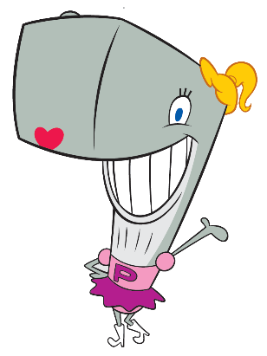
Results Pearl
NLP | Domain Expert
0.102 |  | Sentiment Analysis
 | Teenagers Fashion | Main Topics
*
*
Topic | 5 Top words in each topic | Label
1 | new, daddy, krab, punch, krusty | Life style
2 | pal, hate, kind, nothing, fry | Feelings
3 | nothing, hate, okay, uhh, sponginess | Feelings

Slide 28

Results Plankton
NLP | Domain Expert
0.088 |  | Sentiment Analysis
 | Secret Formula Evil Plans | Main Topics
*
*
Topic | 5 Top words in each topic | Label
1 | krabby, krabs, patty, one, puppy | Food
2 | stir, attention, nostrils, argh, snout | Actions
3 | krabs, time, parry, krabby, puppy | Professional rivalry

Slide 29

Results Mrs. Puff
NLP | Domain Expert
0.101 |  | Sentiment Analysis
 | Driving Class | Main Topics
*
*
Topic | 5 Top words in each topic | Label
1 | class, thing, school, boat, first | Teaching
2 | date, months, proper, poseidon, old | Time
3 | congratulations, improvement, pedestrian, millions, excellent | Driving lessons

Slide 30

Results Squidward
NLP | Domain Expert
0.052 |  | Sentiment Analysis
 | Music, Art | Main Topics
*
*
Topic | 5 Top words in each topic | Label
1 | one, day, time, krabs, two | Work day
2 | button, situations, ball, inspection, annual | Control
3 | clear, inspection, flavor, co-cashier, ball | Work

Slide 31
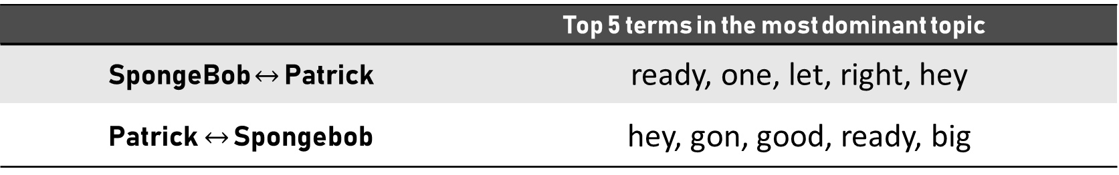
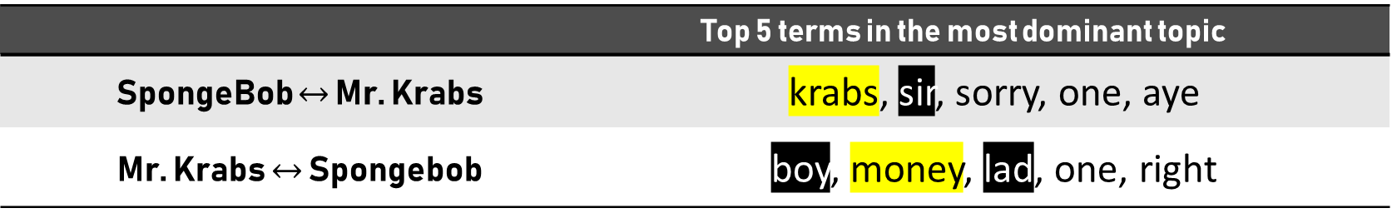
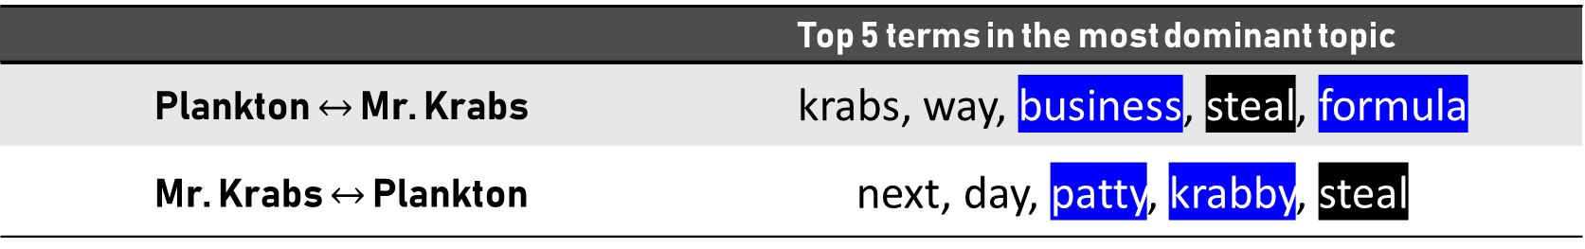
Results Conversations
Top 5 terms in the most dominant topic
krabs, sir, sorry, one, aye | SpongeBob $↔$ Mr. Krabs
boy, money, lad, one, right | Mr. Krabs $↔$ Spongebob
Top 5 terms in the most dominant topic
ready, one, let, right, hey | SpongeBob $↔$ Patrick
hey, gon, good, ready, big | Patrick$↔$ Spongebob
Top 5 terms in the most dominant topic
krabs, way, business, steal, formula | Plankton $↔$ Mr. Krabs
next, day, patty, krabby, steal | Mr. Krabs $↔$ Plankton

Slide 32
Results Conversational sentiment
We compared the sentiment of each character with the sentiment dictated by his conversations with other characters:
We can not significantly conclude that a positive character affects a negative character in their conversations (or vice versa).
Notes:
One exception that we observed is the relationship between Squilliam and Squidward, which are designed to be rivals. Squilliam, which tends to be positive in his overall average sentiment (score of 0.36), turns his conversations with Squidward to be more positive than Squidward’s average sentiment (score of 0.052, which is closer to neutral than to positivity)
סקווגוורד צינית סקווילים מתעמר בסקווילים

Slide 33
Results Social Network
Topic overlap of charact.:
Spongebob, Patrick, Squidward, Mr. Krabs, Squiliam
Larry, Sandy, Pearl, Garry
Plankton, Mermaid-man, Barnacle Boy, Karen, Mrs. Puff
Conversation length varies between charact.

Slide 34
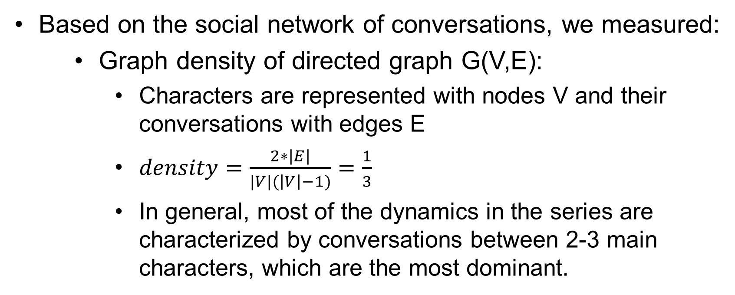
Results Additional Metrics
Based on the social network of conversations, we measured:
Graph density of directed graph G(V,E):
Characters are represented with nodes V and their conversations with edges E
$density=\frac{2∗|E|}{|V|(\left|V\right|−1)}=\frac{1}{3}$
In general, most of the dynamics in the series are characterized by conversations between 2-3 main characters, which are the most dominant.
Notes:
מול פייסבוק

Slide 35
Results Additional Metrics
The proportion of spoken quotes:
The top 5 characters:
Character | Portion of spoken sentences
Backgroud | 41.92%
Spongebob | 25.22%
Squidward | 9.49%
Patrick | 7.16%
Mr. Krabs | 6.04%
Notes:
לפרויקט עתידי, אפשר לבחון את המשפטים של ה-background.

Slide 36
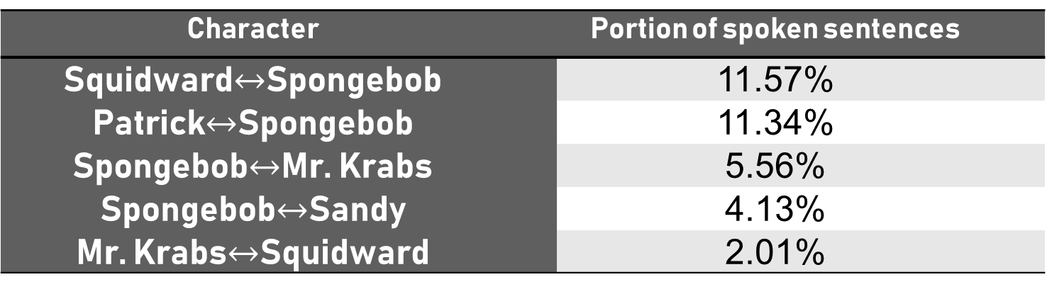
Results Additional Metrics
The proportion of spoken quotes:
The top 5 conversations:
Character | Portion of spoken sentences
Squidward$↔$Spongebob | 11.57%
Patrick$↔$Spongebob | 11.34%
Spongebob$↔$Mr. Krabs | 5.56%
Spongebob$↔$Sandy | 4.13%
Mr. Krabs$↔$Squidward | 2.01%

Slide 37




Conclusions
There is some correlation between the results of topic modeling performed by human expert and a NLP analysis
We have not found strong evidence that will imply that positive characters have an effect on negative characters
Despite the evolving subjects discussed in different episodes, our analysis is representative enough of their social dynamics
There was little correlation between the NLP and human expert sentiment analysis

Slide 38
Future Work
Extracting more transcripts to increase the corpus
Experimenting with other packages for sentiment analysis (which perform better)
Conducting other types of analysis concerning dynamics between characters
Considering group conversations between more than two characters
Change in dynamics over time (seasons)

Slide 39

Questions?

